Slide 1
Diff eq pt 2 ch 5

Slide 2
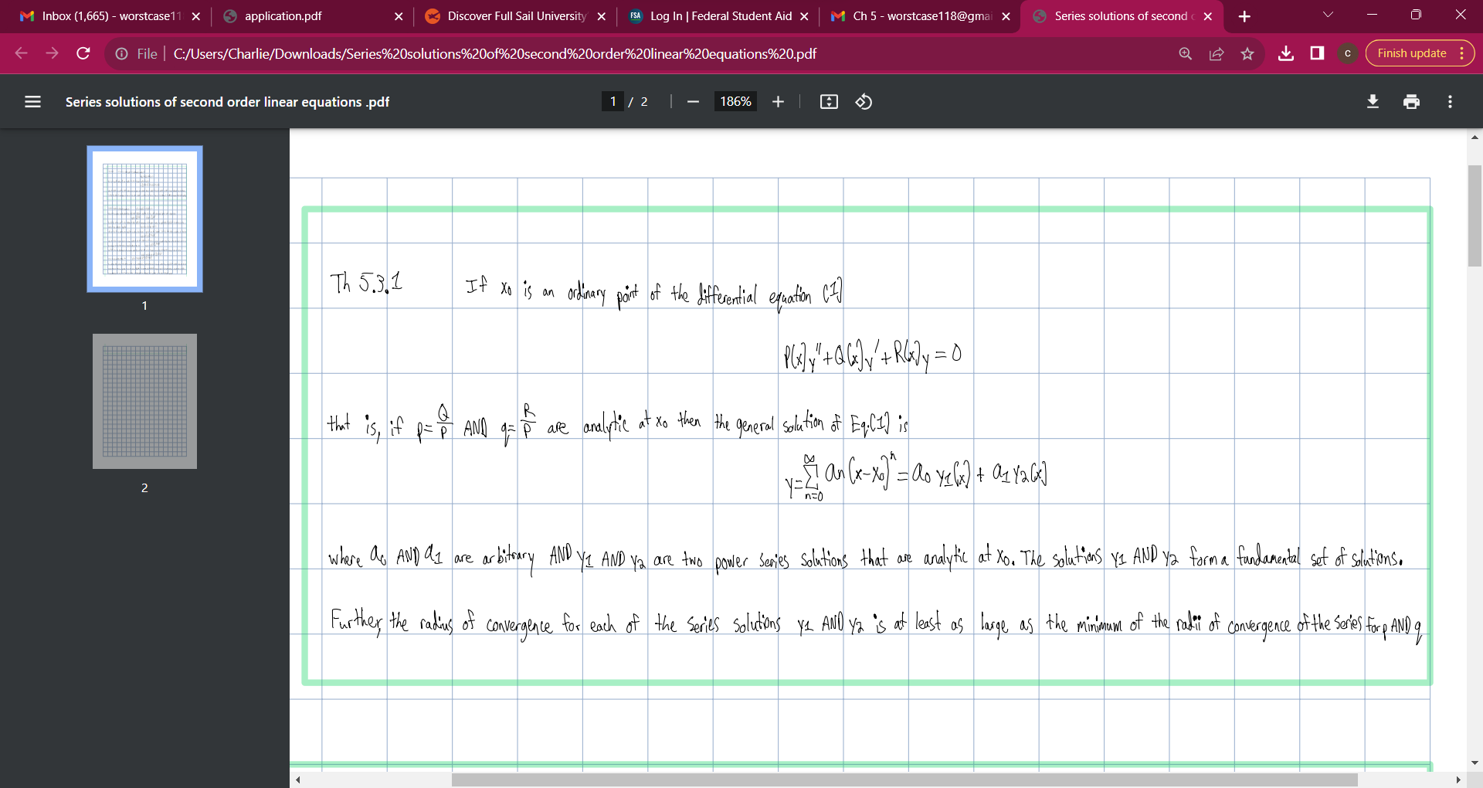

Slide 3
